Slide 1


Grid item properties

Slide 2

Topics
Introduction
Grid item properties

Slide 3
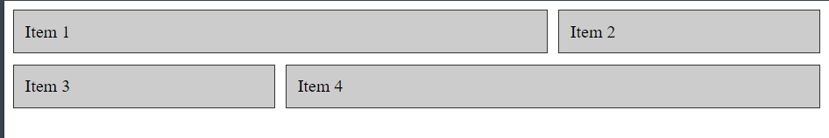
grid-column-start and grid-column-end
This properties define the starting and ending positions of a grid item along the horizontal axis of the grid.
.item1 {
grid-column-start: 1;
grid-column-end: 3;
}
.item2 {
grid-column-start: 3;
}
.item3 {
grid-column-start: 1;
}
.item4 {
grid-column-start: 2;
grid-column-end: 4;
}

Slide 4
grid-column
The shorthand grid-column property for grid-column-start and grid-column-end.
.item1 {
grid-column: 1 / 3;
}
.item2 {
grid-column: 3 / 4;
}
.item3 {
grid-column: 1 / 2;
}
.item4 {
grid-column: 2 / 4;
}

Slide 5
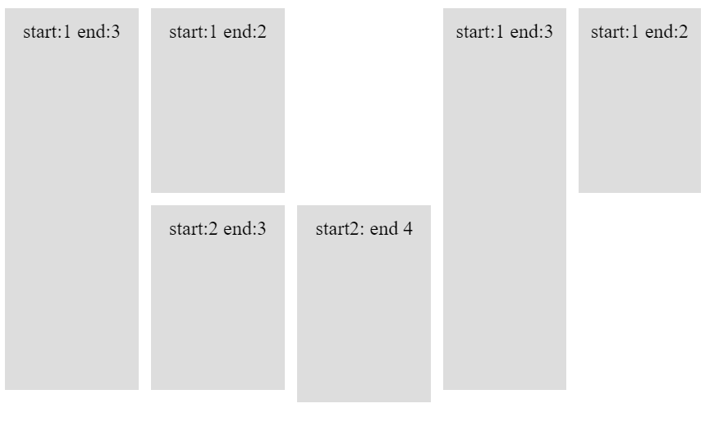
grid-row-start and grid-row-end
grid-row-start and grid-row-end properties define the starting and ending positions of a grid item along the vertical axis of the grid.
.item-1 {
grid-row-start: 1;
grid-row-end: 3;
}
.item-2 {
grid-row-start: 1;
grid-row-end: 2;
}
.item-3 {
grid-row-start: 2;
grid-row-end: 3;
}
.item-4 {
grid-row-start: 2;
grid-row-end: 4;
}
.item-5 {
grid-row-start: 1;
grid-row-end: 3;
}
.item-6 {
grid-row-start: 1;
grid-row-end: 2;
}

Slide 6
grid-row
The shorthand grid-row property for grid-row-start and grid-row-end.
.item-1 {
grid-row: 1 / 3;
}
.item-2 {
grid-row: 1 / 2;
}
.item-3 {
grid-row: 2 / 3;
}
.item-4 {
grid-row: 2 / 4;
}
.item-5 {
grid-row: 1 / 3;
}
.item-6 {
grid-row: 1 / 2;
}

Slide 7
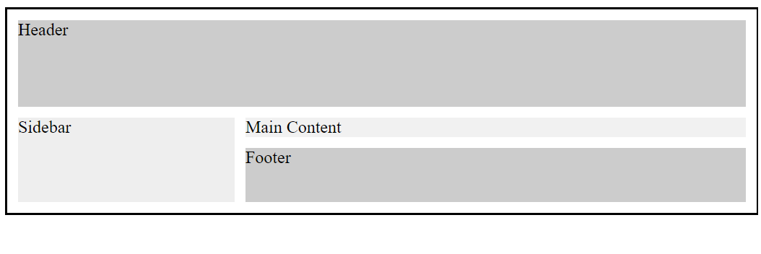
grid-area
grid-area property allows you to specify the starting and ending positions of a grid item along both the horizontal and vertical axes in a single declaration.
.grid-container {
display: grid;
grid-template-areas:
"header header header"
"sidebar main main"
"sidebar footer footer";
grid-template-rows: 80px 1fr 50px;
grid-template-columns: 200px 1fr 1fr;
grid-gap: 10px;
background-color: #fff;
border: 2px solid #000;
padding: 10px;
}
.header {
grid-area: header;
background-color: #ccc;
}
.sidebar {
grid-area: sidebar;
background-color: #eee;
}
.main {
grid-area: main;
background-color: #f1f1f1;
}
.footer {
grid-area: footer;
background-color: #ccc;
}

Slide 8
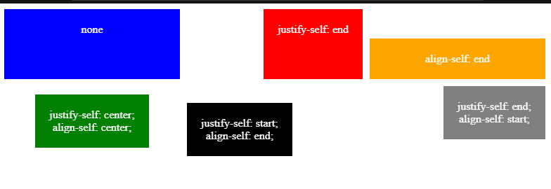
justify-self and align-self
justify-self and align-self properties control the alignment of a grid item within its grid cell along the horizontal and vertical axes, respectively.
.grid-item {
background-color: #ddd;
padding: 20px;
text-align: center;
}
.grid-item:nth-child(2) {
justify-self: end;
}
.grid-item:nth-child(3) {
align-self: end;
}
.grid-item:nth-child(4) {
justify-self: center;
align-self: center;
}
.grid-item:nth-child(5) {
justify-self: start;
align-self: end;
}
.grid-item:nth-child(6) {
justify-self: end;
align-self: start;
}

Slide 9
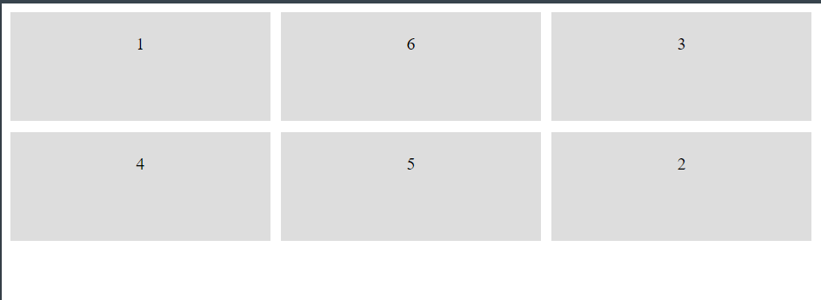
order
The order property defines the order in which a grid item is displayed within its grid container. The value can be a numeric value or the keyword auto.
.grid-item {
background-color: #ddd;
padding: 20px;
text-align: center;
}
.grid-item:nth-child(2) {
order: 6;
}
.grid-item:nth-child(3) {
order: 2;
}
.grid-item:nth-child(4) {
order: 3;
}
.grid-item:nth-child(5) {
order: 5;
}
.grid-item:nth-child(6) {
order: 1;
}

Slide 10
THANK YOU

